Slide 1
The Navier-Stokes Equations
Andrew Palmer and Brian Liao

Slide 2
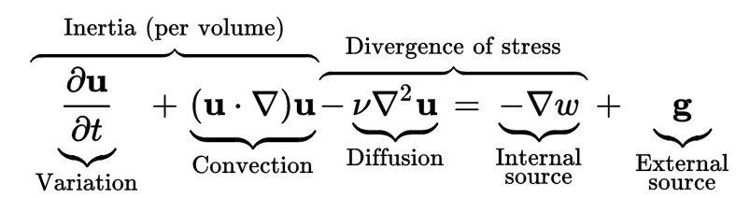
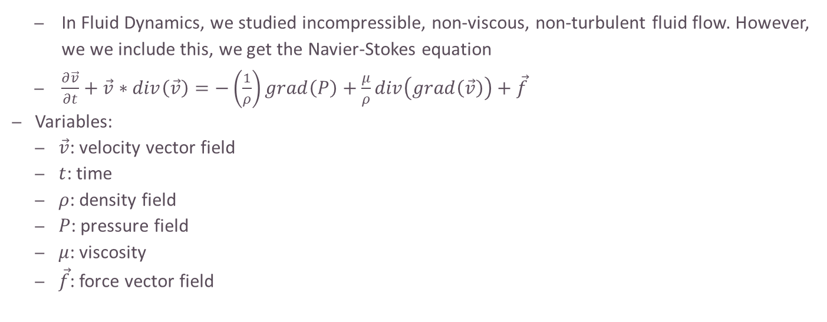
The Navier-Stokes Equation
In Fluid Dynamics, we studied incompressible, non-viscous, non-turbulent fluid flow. However, we we include this, we get the Navier-Stokes equation
$\frac{∂\vec{v}}{∂t}+\vec{v}∗div\left(\vec{v}\right)=−\left(\frac{1}{ρ}\right)grad\left(P\right)+\frac{μ}{ρ}div\left(grad\left(\vec{v}\right)\right)+\vec{f}$
Variables:
$\vec{v}$: velocity vector field
$t$: time
$ρ$: density field
$P$: pressure field
$μ$: viscosity
$\vec{f}$: force vector field

Slide 3
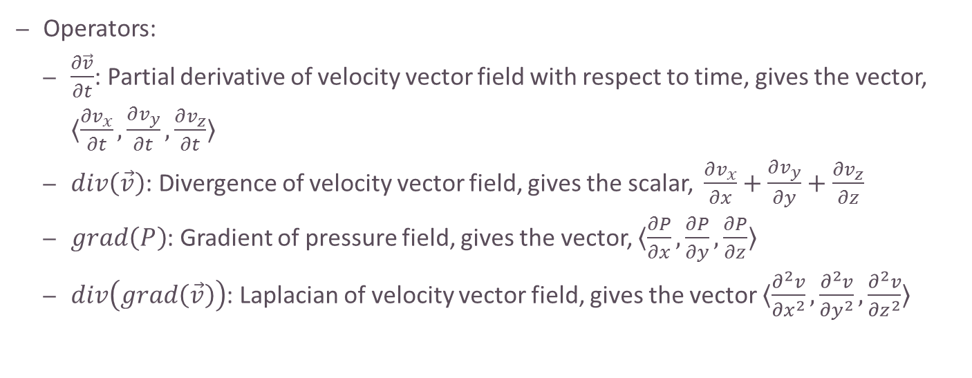
Explanation of the Vector Calculus
Operators:
$\frac{∂\vec{v}}{∂t}$: Partial derivative of velocity vector field with respect to time, gives the vector, $〈\frac{∂v_{x}}{∂t}, \frac{∂v_{y}}{∂t}, \frac{∂v_{z}}{∂t}〉$
$div\left(\vec{v}\right)$: Divergence of velocity vector field, gives the scalar, $\frac{∂v_{x}}{∂x}+\frac{∂v_{y}}{∂y}+\frac{∂v_{z}}{∂z}$
$grad\left(P\right)$: Gradient of pressure field, gives the vector, $〈\frac{∂P}{∂x}, \frac{∂P}{∂y}, \frac{∂P}{∂z}〉$
$div\left(grad\left(\vec{v}\right)\right)$: Laplacian of velocity vector field, gives the vector $〈\frac{∂^{2}v}{{∂x}^{2}},\frac{∂^{2}v}{{∂y}^{2}},\frac{∂^{2}v}{{∂z}^{2}}〉$

Slide 4
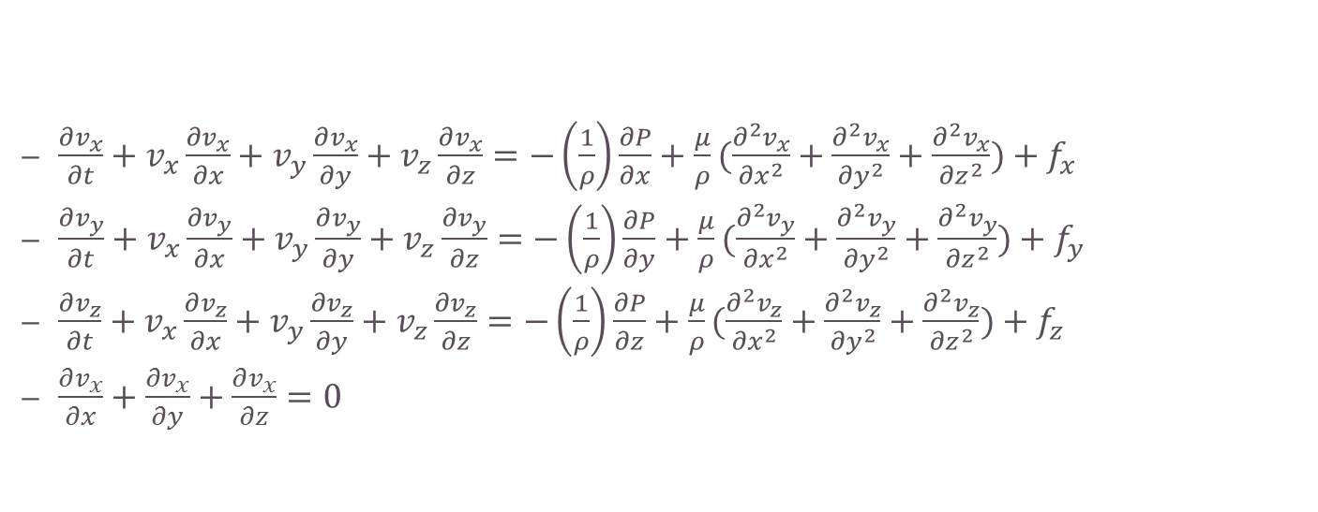
Navier-Stokes Equation Expanded Out
$\frac{∂v_{x}}{∂t}+v_{x}\frac{∂v_{x}}{∂x}+v_{y}\frac{∂v_{x}}{∂y}+v_{z}\frac{∂v_{x}}{∂z}=−\left(\frac{1}{ρ}\right)\frac{∂P}{∂x}+\frac{μ}{ρ}(\frac{∂^{2}v_{x}}{{∂x}^{2}}+\frac{∂^{2}v_{x}}{{∂y}^{2}}+\frac{∂^{2}v_{x}}{{∂z}^{2}})+f_{x}$
$\frac{∂v_{y}}{∂t}+v_{x}\frac{∂v_{y}}{∂x}+v_{y}\frac{∂v_{y}}{∂y}+v_{z}\frac{∂v_{y}}{∂z}=−\left(\frac{1}{ρ}\right)\frac{∂P}{∂y}+\frac{μ}{ρ}(\frac{∂^{2}v_{y}}{{∂x}^{2}}+\frac{∂^{2}v_{y}}{{∂y}^{2}}+\frac{∂^{2}v_{y}}{{∂z}^{2}})+f_{y}$
$\frac{∂v_{z}}{∂t}+v_{x}\frac{∂v_{z}}{∂x}+v_{y}\frac{∂v_{z}}{∂y}+v_{z}\frac{∂v_{z}}{∂z}=−\left(\frac{1}{ρ}\right)\frac{∂P}{∂z}+\frac{μ}{ρ}(\frac{∂^{2}v_{z}}{{∂x}^{2}}+\frac{∂^{2}v_{z}}{{∂y}^{2}}+\frac{∂^{2}v_{z}}{{∂z}^{2}})+f_{z}$
$\frac{∂v_{x}}{∂x}+\frac{∂v_{x}}{∂y}+\frac{∂v_{x}}{∂z}=0$

Slide 5
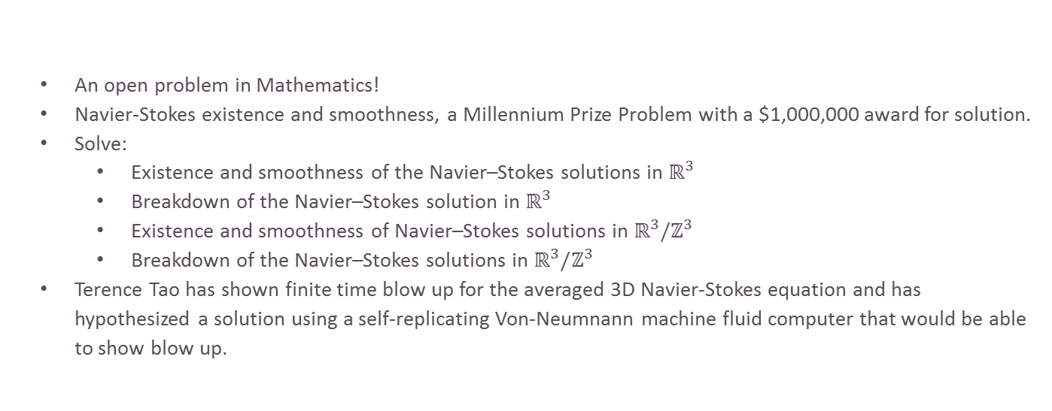
Analytical Solutions of Navier-Stokes?
An open problem in Mathematics!
Navier-Stokes existence and smoothness, a Millennium Prize Problem with a $1,000,000 award for solution.
Solve:
Existence and smoothness of the Navier–Stokes solutions in $ℝ^{3}$
Breakdown of the Navier–Stokes solution in $ℝ^{3}$
Existence and smoothness of Navier–Stokes solutions in $ℝ^{3}/ℤ^{3}$
Breakdown of the Navier–Stokes solutions in $ℝ^{3}/ℤ^{3}$
Terence Tao has shown finite time blow up for the averaged 3D Navier-Stokes equation and has hypothesized a solution using a self-replicating Von-Neumnann machine fluid computer that would be able to show blow up.

Slide 6
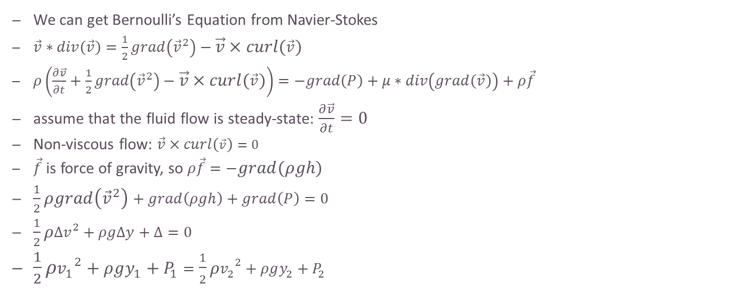
Bernoulli Equation
We can get Bernoulli’s Equation from Navier-Stokes
$\vec{v}∗div\left(\vec{v}\right)=\frac{1}{2}grad\left({\vec{v}}^{2}\right)−\vec{v}×curl\left(\vec{v}\right)$
$ρ\left(\frac{∂\vec{v}}{∂t}+\frac{1}{2}grad\left({\vec{v}}^{2}\right)−\vec{v}×curl\left(\vec{v}\right)\right)=−grad\left(P\right)+μ∗div\left(grad\left(\vec{v}\right)\right)+ρ\vec{f}$
assume that the fluid flow is steady-state: $\frac{∂\vec{v}}{∂t}=0$
Non-viscous flow: $\vec{v}×curl\left(\vec{v}\right)=0$
$\vec{f}$ is force of gravity, so $ρ\vec{f}=−grad\left(ρgh\right)$
$\frac{1}{2}ρgrad\left({\vec{v}}^{2}\right)+grad\left(ρgh\right)+grad\left(P\right)=0$
$\frac{1}{2}ρΔv^{2}+ρgΔy+Δ=0$
$\frac{1}{2}ρ{v_{1}}^{2}+ρgy_{1}+P_{1}=\frac{1}{2}ρ{v_{2}}^{2}+ρgy_{2}+P_{2}$

Slide 7
Numerical Methods
Use a computer to iteratively get solutions
Examples:
Euler’s Method
Runge-Kutta 4
PDE’s
Finite Elements Method
Finite Difference Method
Finite Volume Method
Don’t know how to do any

Slide 8
Code Walkthrough
https://github.com/andrew-pa/fluidynm

Slide 9
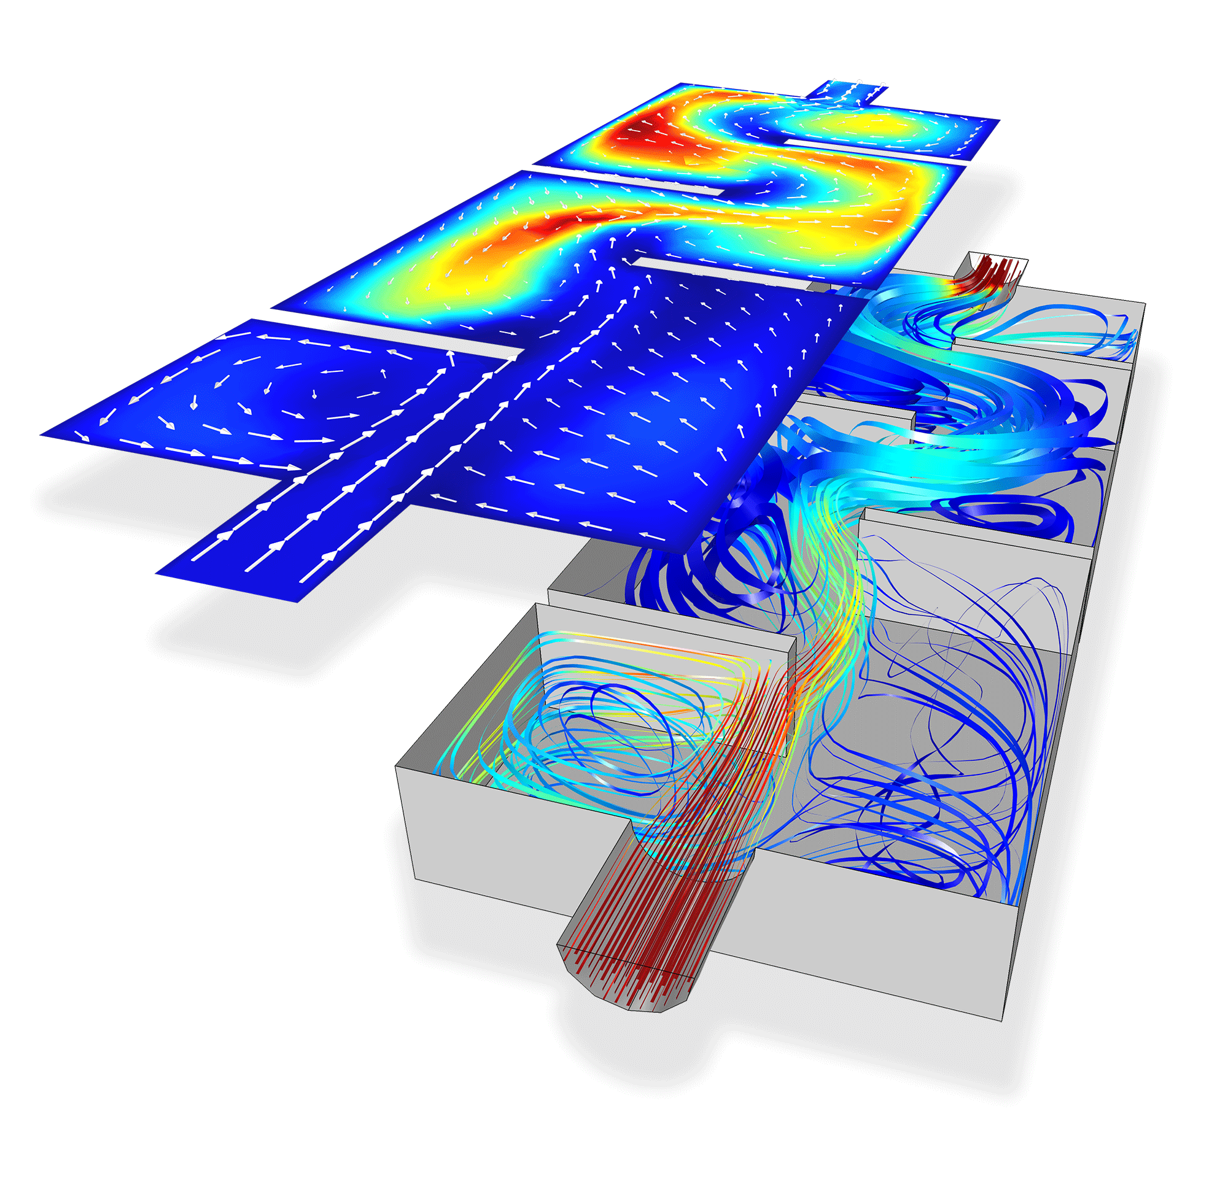
Actual Water
“I’m researching if water can spontaneously blow up” - Terence Tao
While we simulate fluid flow, we assume that fluid is a continuous density field
Water is actually made of molecules, so this assumption is not actually true
This just makes approximations to how fluid might act because simulating molecular and atomic dynamics with quantum effects is nearly computationaly impossible.

